Slide 1

EMPATO AI
ADEPTS

Slide 2
About project
Our project is the expert system that tracks people’s reaction to social phenomenon.
It’s assignment belongs in creating accurate statistics of real crowd feelings about something.

Slide 3
SO WHERE CAN WE USE IT ?

Slide 4
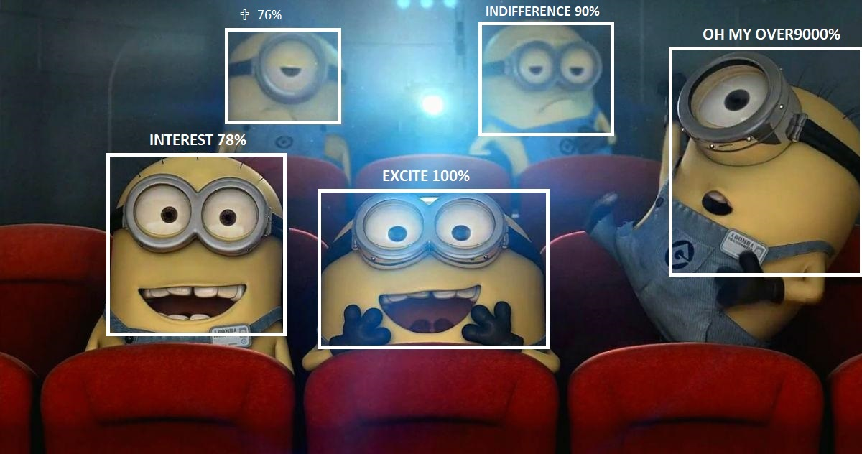
Ми дибіли

Slide 5
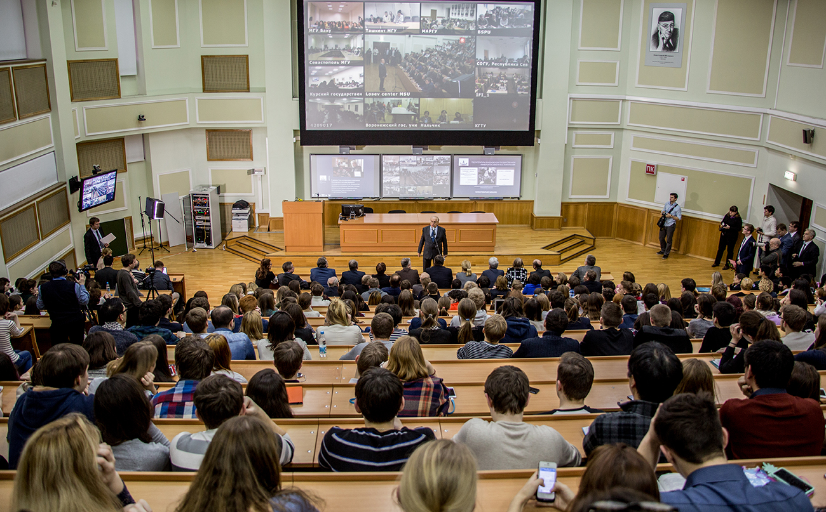

Slide 6
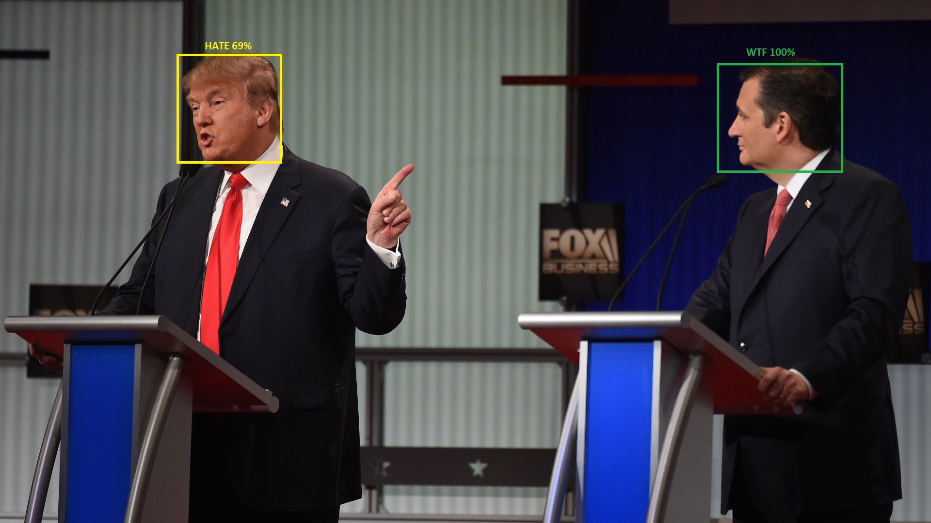

Slide 7
TECHNOLOGIES
Python 3.6
OpenCV
TensorFlow
Flask
MatPlotLib

Slide 8
How it works?
OpenCV tracks video in real-time from camera
Neural Network finds face(s)
Another network analyze emotion, what can be: interest, anger, indifference, surprise etc.
Script creates statistics
Matplotlib visualizes it
And all of it runs on Flask backend

Slide 9
Work plan
Create working model
Create statistics software
Create website
Retrain network with custom emotions

Slide 10
About us
Vlad0$$ - face detection, statistics
KeШych - face detection, backend
Ru//a - emotion recognition, frontend
NaZZig - object detection, statistics

Slide 11


