Slide 1




“
“Community Health Clinic of Lviv Polytechnic”
as one step
on the way of sustainable development of the Social Work Education Program of Lviv Polytechnic National University
«Клініка здоров’я громади Львівської політехніки»
як крок на шляху сталого розвитку Освітньої програми соціальної роботи Національного університету «Львівська політехніка»
Dr. Nina Hayduk, Head of the Social Work Education Program (since 1999); Director of International “INTEGRATION” Centre for Professional Partnerships; PhD in Education, Associate Professor
Dr. Liliia Klos, Acting Head of the Department of Sociology and Social Work, MD, DSc in Education, Associate Professor
Dr. Larysa Klymanska, Head of the Department of Sociology and Social Work (2005-2019), DSc in Political Science, Professor
International Scientific and Practical Conference “Partnerships for Social Change: 20 Years of Experience” Lviv Polytechnic National University, Ukraine
October 24-26, 2019

Slide 2
“Community Health Clinic of Lviv Polytechnic”
The Presentation Purpose:
To justify the establishment of Community Health Clinic as an indication of the sustainable development of the Social Work Education Program of Lviv Polytechnic National University
Our Questions:
What has been implemented since 2011?
What is being implemented?
What is projected to be implemented?

Slide 3
DEFINING KEY NOTIONS
PERSON WITH SPECIAL EDUCATIONAL NEEDS – an individual who needs additional permanent or temporary support in the process of studies in order to ensure her/his right to education
WAR VETERAN – a person who has participated in hostilities to defend the Motherland or in fighting operations on the territory of other states. The war veterans include combatants, persons with disabilities due to the war, and participants in the war
DEPENDENCE is a complex of physiological, behavioral and cognitive phenomena, among which the behavior associated with the use of a psychoactive substance receives a significant advantage over other forms of behavior that were characteristic of a given person (International Classification of Diseases ICD-10)
HUMAN IN DIFFICULT LIFE CIRCUMSTANCES – a person in the circumstances that adversely affect life, health and his/her development, which a person cannot overcome independently (The Law “On Social Services” of 17.01.2019)
INCLUSIVE EDUCATION POLICY – purposeful activities at the international, national, regional and local levels associated with the adoption of responsible decisions, i.e., laws, regulations, orders and procedures in the field of inclusive education
SOCIAL INCLUSION – a process aimed at providing vulnerable individuals and groups with the opportunities and resources needed to fully participate in social, economic and cultural life and to enjoy a standard of living and wellness in line with the quality of life standards
INCLUSIVE, ACCESSIBLE, HEALTHY EDUCATIONAL ENVIRONMENT - a set of conditions, methods and means of their implementation for joint training, educational activities and development of education applicants, based on their needs and capabilities
INCLUSIVE, ACCESSIBLE, HEALTHY UNIVERSITY

Slide 4
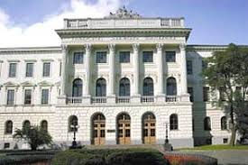
The CONCEPT OF A HEALTHY UNIVERSITY
Healthy policy of sustainable development at the University
Healthy working (academic, educational) environment
Healthy personality, & human and creative development of the involved individuals
-
-
-
-
-
-
Primary health care services to address the needs of students, faculty, & support staff
Healthy, safe, accessible physical environment
The wide academic community interest in the development & promotion of health
The development of relations/partnerships with community

Slide 5
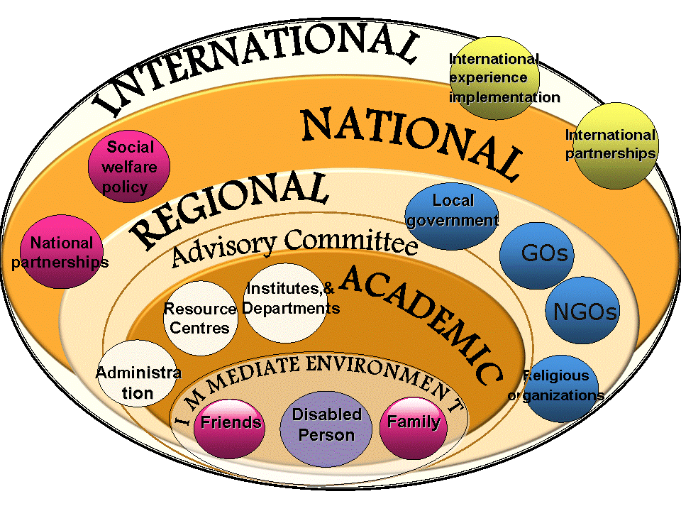
Adjust the Environment, but not the Person

Slide 6
RESEARCH. NEEDS ASSESSMENT
In 2018-2019, at Lviv Polytechnic
- there are studying in the full-time education programs:
225 students with disabilities;
2 students – participants of АТО (Antiterrorist operation);
508 students – children of participants of АТО;
8 students – children of perished participants of АТО;
153 students – IDPs (internally displaced persons)
- there are working:
227 staff members with disabilities,
including the faculty – 69 persons; among them: 4 persons – 1st group of disability, 46 persons – 2nd group of disability, and 177 persons – 3rd group of disability
_____
1 in 4 Ukrainians suffering from alcohol addiction is under the age of 35.
22% of school children and students of higher educational establishments drink alcohol almost every day or several times a week.

Slide 7
RESEARCH. NEEDS ASSESSMENT
2016 – The first wave of the “Research of Lifestyle Risks of the Contemporary Youth” was conducted.
The purpose – monitoring risk-taking behaviors and use of psychoactive substances by the student youth.
The methods of the so-called “Mokotów research”, conducted by the Institute of Psychiatry and Neurology (Warsaw, Poland) since 1984 and repeated every 4 years, were applied.
The following risk-taking behaviors were indicated:
  abuse of alcohol,
  abuse of other psychoactive substances, &
  “freeze on the Internet”
Among respondents (15-year-old school children):
  have tried alcohol – 47%;
  have the experience of using drugs – 4%;
  have smoked cigarettes – 10%;
  have used medicinal products for non-medicinal purposes – 21 %

Slide 8
What HAS BEEN implemented? Resources IDENTIFICATION
The transformation of the learning environment / the development of
a barrier-free architectural space is going on:
The work is done to ensure the architectural accessibility of academic buildings # 1 and # 5, and hostel # 8;
The project to transform hostel # 6 is developed;
The monitoring of the University infrastructure accessibility is taking place.
Educational and scientific institutes are developing innovative strategies, technologies and acquiring new experience in teaching students with disabilities and chronic illnesses.

Slide 9
What HAS BEEN implemented? Resources IDENTIFICATION
2011 – The Resource Center for Educational Information Technology for Persons with Disabilities (total visual impairment) of Lviv Polytechnic was established.
December 2015 – International “INTEGRATION” Centre for Professional Partnerships was founded.
2016 – The Model (PATHWAY) of individual support of persons with disabilities and chronic illnesses in their studies was developed.
“No Limits” Partnerships Networking was launched to reach out and involve partner universities and other institutions at the international, national, regional and local levels.
2017 – At Lviv Polytechnic, there were organized:
“No Limits” Services of Accessibility to Learning Opportunities, as introduced within the structure of International “INTEGRATION” Centre for Professional Partnerships;
A Multidisciplinary Team consisting of representatives of different Educational and Scientific Institutes was formed.

Slide 10
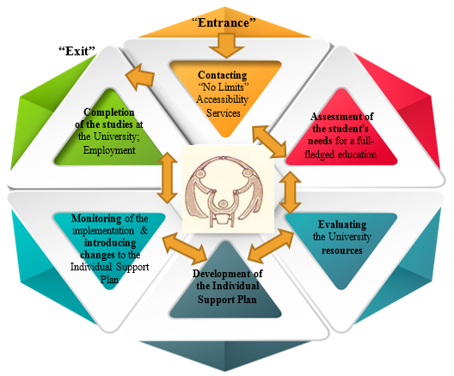
Model (Pathway) of individual support of people with disabilities and chronic illnesses at lviv polytechnic

Slide 11
“NO LIMITS” ACCESSIBILITY SERVICES TO LEARNING OPPORTUNITIES
Mission: to provide actual access to learning opportunities at Lviv Polytechnic based on the recognition of the intrinsic value and dignity of every person in society regardless of her/his individual peculiarities
Goal: to ensure continuous supervision of the education process of students with disabilities and chronic illnesses
Main Objectives:
Місія: забезпечення реального доступу до можливостей навчання у Львівській політехніці на засадах визнання невід’ємної цінності і гідності кожної людини у суспільстві незалежно від її індивідуальних особливостей
Мета: забезпечення здійснення постійного супроводу навчального процесу студентів з інвалідністю та хронічними захворюваннями
Основні завдання:
Місія: забезпечення реального доступу до можливостей навчання у Львівській політехніці на засадах визнання невід’ємної цінності і гідності кожної людини у суспільстві незалежно від її індивідуальних особливостей
Мета: забезпечення здійснення постійного супроводу навчального процесу студентів з інвалідністю та хронічними захворюваннями
Основні завдання:
Formation of inclusive consciousness
Understanding of the problem of functioning of persons with disabilities and chronic illnesses in the education environment
Needs assessment of persons with disabilities and chronic illnesses
Identification and evaluation of University resources
Development and implementation of the Individual Support Plan
Identification and adaptation of innovative strategies, technologies and experiences in the area of social inclusion and inclusive education
Facilitating the transformation of the University into a barrier-free educational space with real access to learning opportunities for people with special educational needs

Slide 12
The System of inclusive education services
of lviv polytechnic

Slide 13

What IS BEING IMPLEMENTED?
Since 2014 – The “Ukraine-Norway” project “Retraining and Social Adaptation of Military Officers and Their Family Members in Ukraine” is being implemented on ongoing basis at Lviv Polytechnic.
2017-2019 – The conceptual foundations of the development of new University services are justified, & The new University services are organized:
Veteran Services for combatants, their family members and internally displaced persons (IDPs);
Counselling & Coordination Services “Community Health Clinic of Lviv Polytechnic” to ensure access to education and healthcare and promote the observation of every person’s right to health and health promotion.

Slide 14
VETERAN SERVICES FOR COMBATANTS, THEIR FAMILIES, & IDPS
Goal: to provide training and support services to students-veterans of war, students - members of families of veterans of war, internally displaced persons; and to ensure provision of necessary information and assistance at a higher educational institution
Main Objectives:
To assist:
- during the admissions campaign and studying at the University, including filling in the documents and explanations of existing rules and procedures;
- in the interpretation of the legislation relating to veterans of war;
- in the preparation of documents for obtaining existing benefits for veterans of war
To arrange:
- comfortable space for learning and relaxation;
- a separate location on the territory of the University and provide a real opportunity for veterans of war to meet and spend time together;
- mobilization of the University resources in the area of Adapted Physical Activity (APA) and sports for rehabilitation implementation
To ensure:
- academic supervision and necessary support;
- mediation between students-veterans and professors;
- individual counseling;
- referrals to other services and resources (when needed)
To organize :
- master classes, seminars, other types of adapted activities / problem solving events for veterans;
- therapeutic leisure time events

Slide 15



PUSH TOWARDS THE CONCEPT OF A HEALTHY UNIVERSITY DEVELOPMENT
2015 – 2019
“The Eastern Partnership” initiative of the Federal Foreign Office of Germany
2019
Inclusive and Healthy University Project, ÖPR19-164
Sports Center, Julius-Maximilians-University Würzburg

Slide 16
PUSH TOWARDS THE CONCEPT OF A HEALTHY UNIVERSITY DEVELOPMENT
2016 – 2019
The cooperation with the State Agency for the Prevention of Alcohol-Related Problems (PARPA) in Poland
2018
The beginning of work on the Program to counteract alcohol and drug addiction among children and youth in the Lviv Region

Slide 17
SOCIAL INCLUSION VIA SOCIAL REHABILITATION
2019
The beginning of taking the course “Training personnel to develop a dependence therapy education system in Ukraine” at the Institute of Psychiatry and Neurology of Maria Grzegorzewska Academy of Special Pedagogy (Warsaw, Poland)
The purpose – to train trainers from among lecturers of the three universities of Lviv and practitioners from Drohobych “Nazareth” Centre (Lviv region) to provide counselling on the matters of dependences

Slide 18
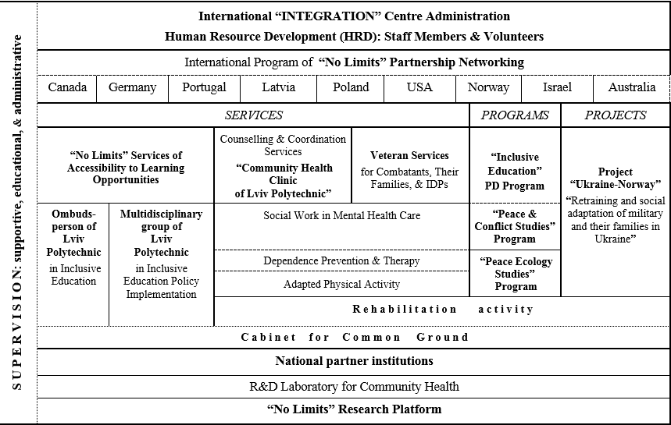

THE STRUCTURAL-FUNCTIONAL MODEL of
International “Integration” Centre for Professional Partnerships of Lviv Polytechnic National University

Slide 19
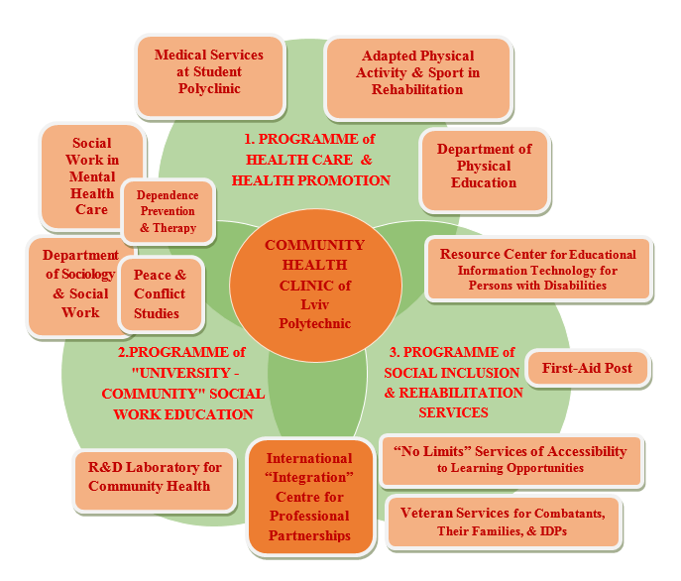
THE MODEL OF THE IMPLEMENTATION OF
THE HEALTHY COMMUNITY DEVELOPMENT STRATEGY

Slide 20
WHAT IS PROJECTED TO BE IMPLEMENTED?
The exploration, application and dissemination of
innovative strategies, technologies and expertise
in social work and social work education built on multidisciplinary effort
Based on the Three Pillars:
(1) “No Limits” partnerships networking,
(2) Scientific Research, &
(3) Community-based activity
NOW REHABILITATION IS COMING TO THE FORE!

Slide 21

CONCLUSION
In carrying out its counselling and coordination functions, “Community Health Clinic of Lviv Polytechnic” is going beyond the academic community and extending to the community of the city, which indicates the sustainable development of the Social Work Education Program launched under Canada-Ukraine Reforming Social Services Project, funded by CIDA (1999 – 2003).

Slide 22
THANK YOU FOR YOUR COOPERATION AND SUPPORT!!!

