Slide 1
Erasmus+ Jean Monnet Modules 2019 "Logistics and Supply Chain Management: dissemination of European experience"
Department of Marketing and Logistics Lviv Polytechnic National University

Slide 2
Background of the project Dissemination of the best European practices in logistics and supply chain management is largely able to form in the target audience:  adequate logistic thinking,  logistic awareness and  logistics behavior
Target audience of the project
- Practitioners
entrepreneurs, managers, authorities
- Pupils
middle and senior classes of schools in Lviv
- Students
of Lviv Polytechnic
National University
of all specialties,
1st, 2nd and 3rd levels of higher education

Slide 3
Objectives (іn relation to the general objectives of the Jean Monnet Activities)
1.
Dissemination of European experience in implementing the best logistics practices
2.
Providing the target audience with professional knowledge on European practices in supply chains management
3.
Promoting a European approach to provide the integration of science, business and authorities

Slide 5
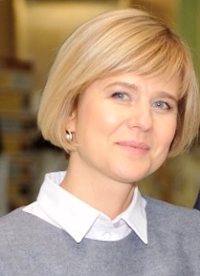
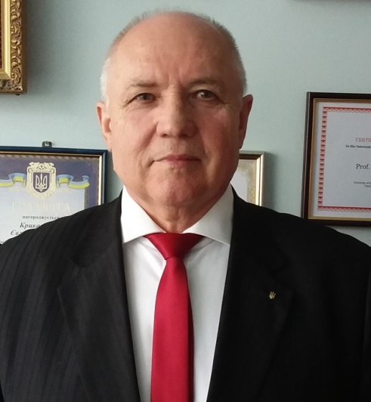
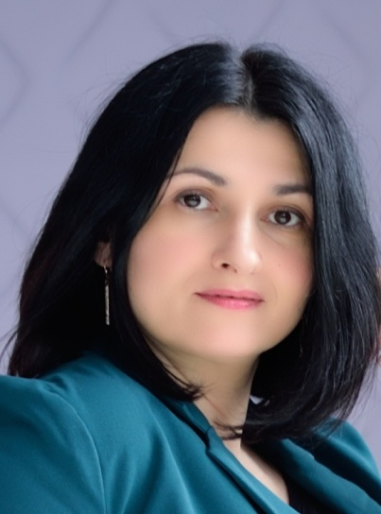
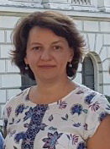
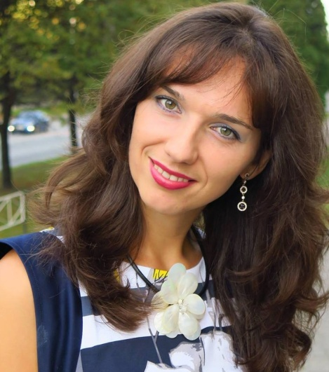
Yevhen Krykavskyy Project Team Member
Project Team
Olena Pokhylchenko
Project Team Member
Nataliya Chornopyska
Project Team Member
Nataliya Hayvanovych
Academic Сoordinator
Sofia Leonova
Project Team Member
Oksana Dovhun
Project Team Member

Slide 6
Project action Plan 2019-2022
Teaching the discipline «LOGISTICS AND SUPPLY CHAIN MANAGEMENT: DISSEMINATION OF EUROPEAN EXPERIENCE»
(for students of all specialties, 1st and 2nd levels of higher education)
International Conference "Marketing and Logistics in the System of Management "
Student Scientific Conference
European Supply Chain Day
Summer school
Excursions

Slide 7
THE PROGRAM OF THE DISCIPLINE "LOGISTICS AND SUPPLY CHAIN MANAGEMENT: DISSEMINATION OF EUROPEAN EXPERIENCE"
Topic 1. Logistics is an instrument of market economy. Experience of European countries in the application of logistics
Topic 2. Fundamental principles of logistics.
Topic 3. Supply chains. Principles of supply chains functioning in the context of European integration
Topic 4. Integration of logistics processes in supply chains: experience of logistics development in EU countries
Topic 5. Logistics in the strategic development of supply chains: features of logistics development in EU countries
Topic 6. Efficiency of supply chains: the best examples of European logistics practice
Topic 7. Achievement of competitive advantages by supply chains: European experience
Topic 8. Prospects for the development of logistics and supply chains in Europe and in the world.

Slide 8
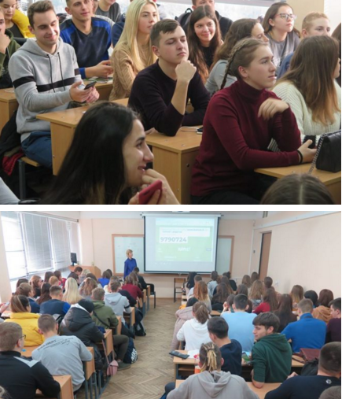
ABOUT THE DISCIPLINE "LOGISTICS AND SUPPLY CHAIN MANAGEMENT: DISSEMINATION OF EUROPEAN EXPERIENCE"
A balanced combination of theoretical and practical approaches to the discipline teaching with the active use of modern information technologies (educational software environment, electronic teaching materials) and active teaching methods (case study, role and business games, etc.) provides an opportunity to introduce not only economic specialties students, but also all specialties of the LPNU with the
- best European practices in logistics and supply chain management,
- European standards, procedures and rules of logistics activities in accordance with the standards of the European Logistics Association, international and national standards.
- The information provided will contribute to distribution of relevant knowledge about European experience in the field of education, where there is usually no EU dimension,
- and should give the target audience an understanding of the essence and role of creating an effective logistics infrastructure as an important factor in the country's GDP growth and integration into the European and world economic community.
This will increase the training quality of specialists that are able to implement European principles, rules and standards in the field of logistics in various sectors of the economy (transport, road design, construction, etc.).

Slide 9
FOLLOW THE PROJECT NEWS
LOGISTICS AND SUPPLY CHAIN MANAGEMENT:
DISSEMINATION OF THE EUROPEAN EXPERIENCE
Fb: https://www.facebook.com/logistics.scm.lpnu
Instagram: https://www.instagram.com/logistics_scm_lpnu
Web-page: https://lpnu.ua/logistics-scm
Web-page ML Departm.: http://ml.lp.edu.ua/
Fb : https://www.facebook.com/ml.nulp/
Instagram: https://www.instagram.com/ml_lpnu/
Youtube: https://www.youtube.com/channel/UCmnSF5G3EoVQyHX4t0_3KmQ

